Slide 1
English Stylistics
Week 6
Rhymes & rhyming patterns

Slide 2
A quick review
Phonology
→ phonemes/ sounds
→ supra-segmental features
Sound effects
→ phonaesthesia 联觉
→ onomatopoeia 拟声

Slide 3
Supra-segmental features
→ Syllable structures
→ Rhymes in English
→ Rhyming patterns in English poetry

Slide 4
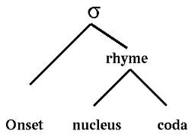
Syllable structure

Slide 5
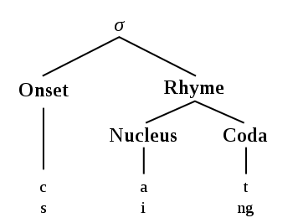

Slide 6
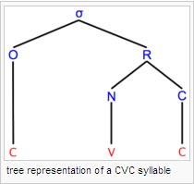
A CVC syllable

Slide 7
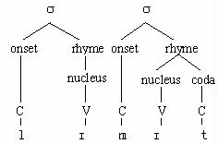

Slide 8
Syllable structures in Chinese
Monosyllabic
(C)V(C)
双声（犹豫、慷慨、崎岖）
叠韵（苗条、蜿蜒、蹉跎）

Slide 9
Syllable structures in English
Multi-syllabic
think spring sixths
(C)(C)(C)V(C)(C)(C)(C)

Slide 10
Rhymes in use
Go well, go Shell.
Rock ‘n’ Roll
Brain drain
Poetry, drama, ads, speeches, etc.
→ sonic, poetic, mnemonic effects

Slide 11
Rhymes in English
Alliteration (CVC) – great/ grow
Rhyme (CVC) – send/ mend
Assonance (CVC) – send/ bell
Consonance (CVC) – send/ hand
Reverse rhyme (CVC) – great/ graze
Pararhyme (CVC) – send/ sound

Slide 12
Other rhymes
Semi-rhymes
→ mend – ending
Imperfect rhymes
→ caring – wing
Eye rhymes/ sight rhymes
→ bone – none

Slide 13
Identify the rhyming words
Rat race.
Mom-and-pop shops
Safe and sound
think tank
Witch Watch Swatch

Slide 14
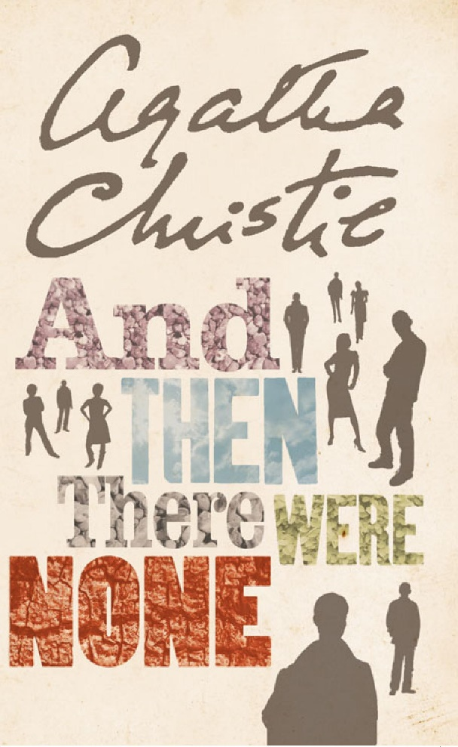
In-class exercise: Text 18
Ten Little Soldier Boys
Frank Green (1879)
And Then There were None by Agatha Christie (1939)

Slide 15
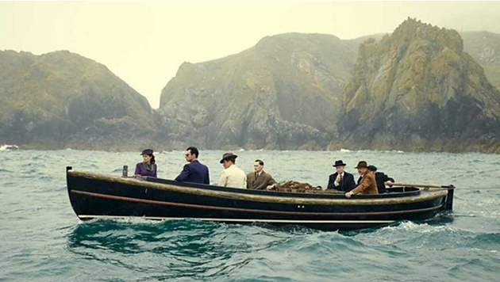
Ten little soldier boys went out to dine;
One choked his little self and then there were Nine.
Nine little soldier boys sat up very late;
One overslept himself and then there were Eight.

Slide 16

Eight little soldier boys traveling in Devon;
One said he’d stay there and then there were Seven.
Seven little soldier boys chopping up sticks;
One chopped himself in halves and then there were Six.

Slide 17
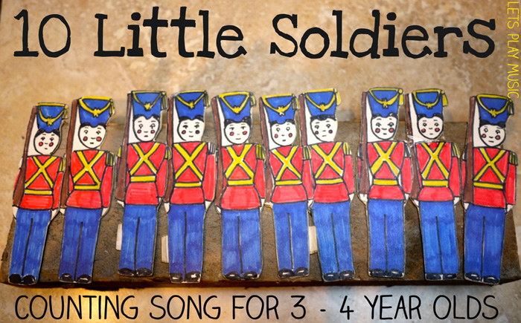
Six little soldier boys playing with a hive;
A bumblebee stung one and then there were Five.
Five little soldier boys going in for law;
One got into chancery and then there were Four.

Slide 18
Four little soldier boys going out to sea;
A red herring swallowed one and then there were Three.
Three little soldier boys walking in the zoo;
A big bear hugged one and then there were Two.

Slide 19
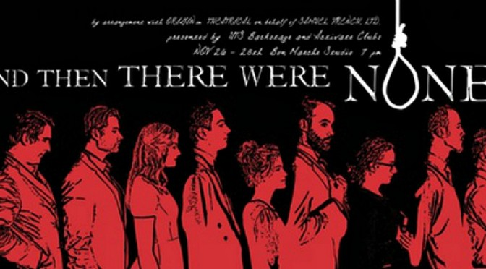
Two little soldier boys sitting in the sun;
One got frizzled up and then there was One.
One little soldier boy left all alone;
He went and hanged himself. And then there were None.

Slide 20
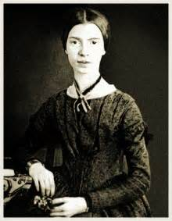
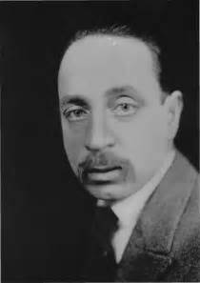
Rhyming patterns in poems (Text 19-20)
Emily Dickinson (1830-1886)
Rainer Maria Rilke (1875-1926)

Slide 21
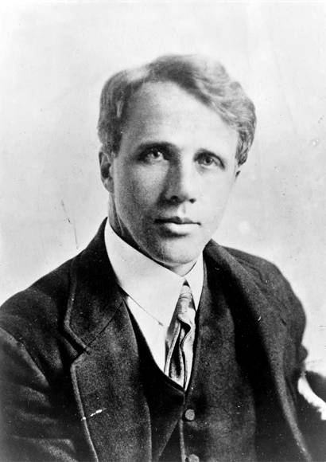
End rhymes → Rhyming patterns (Text 21)
Whose woods these are I think I know, His house is in the village, though; He will not see me stopping here To watch his woods fill up with snow.
Robert Frost (1874-1963)
Rhyming patterns/ schemes: AABA

Slide 22
雪晚林边歇马（余光中 译）
我想我认得这座森林。林主的房子就在前村；
却看不见我在此歇马，看他林中飘满的雪景。
我的小马一定很惊讶，周围望不见什么人家，
竟在一年最暗的黃昏，寒林和冰湖之间停下。

Slide 23
雪晚林边歇马（余光中 译）
马儿摇响身上的串铃，问我这地方该不停。
此外只有微风吹拂雪片，再也听不到其他声音。
森林又暗又深真可羡，但是我已经有约在先，
还要赶多少路才安眠，还要赶多少路才安眠。

Slide 24
To Autumn by John Keats
Season of mists and mellow fruitfulness,
Close bosom-friend of the maturing sun;
Conspiring with him how to load and bless
With fruit the vines that round the thatch-eves run;
Rhyming pattern: ABAB

Slide 25
Rhyming patterns in English poetry
Alternate rhyme: ABAB CDCD EFEF…
Couplet: AABBCCDD
Enclosed rhyme: ABBA
Keatsian ode: ABABCDECDE
Rhyme Royal: ABABBCC

Slide 26
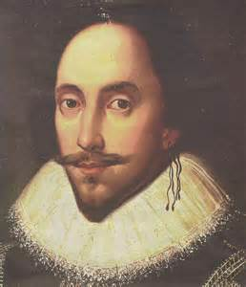
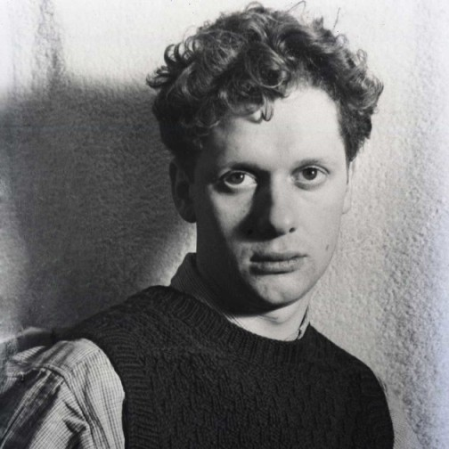
Exercise: Text 22-23
William Shakespeare (1564-1616)
Dylan Thomas (1914-1953)

